Slide 1

Collection frameworks
Group members:
Amrutha M Nair 245138
JENSON MATHEW 245048
ANIRUDH G 245099
BLESSON JOHN ABRAHAM 245045

Slide 2
COLLECTION FRAMEWORKS
The Collection in Java is a framework that provides an architecture to store and manipulate the group of objects.
Java Collection means a single unit of objects. Java Collection framework provides many interfaces and classes
Interfaces : Set, List, Queue, Deque
Classes : ArrayList, Vector, LinkedList, PriorityQueue, HashSet, LinkedHashSet, TreeSet

Slide 3
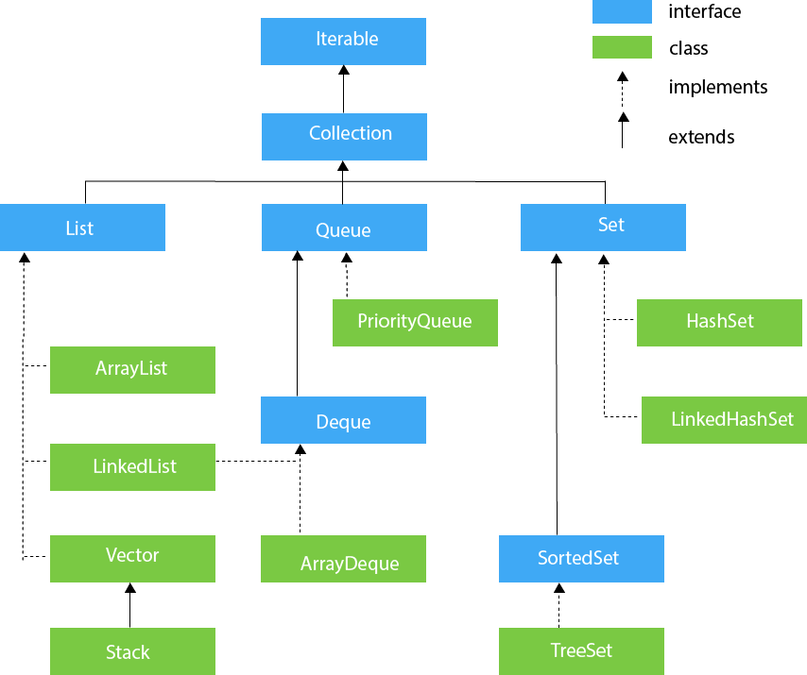
Hierarchy

Slide 4
ARRAY LIST

Slide 5

What is Array list ?
Array List class uses a dynamic array for storing the elements.
It is like an array, but there is no size limit.
We can add or remove elements anytime. So, it is much more flexible than the traditional array.
It is found in the java.util package

Slide 6
features
The important points about the Java Array List class are:
It can contain duplicate elements.
It maintains insertion order.
It is non synchronized.
It allows random access because it works on an index basis.

Slide 7
creation
We cannot create an array list of the primitive types, such as int, float, char, etc. It is required to use the required wrapper class in such cases. For example:
ArrayList<int> al = ArrayList<int>(); // does not work
ArrayList<Integer> al = new ArrayList<Integer>(); // works fine

Slide 8
Basic operations of array list
The ArrayList class provides various methods to perform different operations on arraylists. We will look at some commonly used arraylist operations:
Add elements
Access elements
Change elements
Remove elements

Slide 9
Add elements on array list
To add a single element to the arraylist, we use the add() method of the ArrayList class.
a.add("Java");
a.add("C");
a.add("Python");
//[Java,C,Python]

Slide 10
Access elements on array list
To access an element from the arraylist, we use the get() method of the ArrayList class. For example,
animals.add("Cat"); animals.add("Dog"); animals.add("Cow");
String str = animals.get(1);
//Dog

Slide 11
Change elements from array list
To change elements of the arraylist, we use the set() method of the ArrayList class. For example,
languages.add("Java"); languages.add("Kotlin"); languages.add("C++"); languages.set(2, "JavaScript");
// [ Java,Kotlin,Javascript ]

Slide 12
Remove elements from array list
To remove an element from the arraylist, we can use the remove() method of the ArrayList class. For example,
animals.add("Dog"); animals.add("Cat"); animals.add("Horse"); animals.remove(2);
// [Dog,Cat]

Slide 13
advantages
ArrayList is variable length.
Add any type of data into ArrayList.
ArrayList allows Multiple null values.
ArrayList allows to add duplicate elements.

Slide 14
Disadvantages
ArrayList are relatively slower because of its dynamic nature.
ArrayList do not work on primitive datatypes.
Inefficient insertion/deletion.
Searching for an element in an arraylist can be slow

Slide 15

Linked list

Slide 16

What is linkedlist
A linked-list is a sequence of data structures which are connected together via links.
Linked List is a sequence of links which contains items. Each link contains a connection to another link. Linked list the second most used data structure after array. Following are important terms to understand the concepts of Linked List.
•Link − Each Link of a linked list can store a data called an element.
•Next − Each Link of a linked list contain a link to next link called Next.
•LinkedList − A LinkedList contains the connection link to the first Link called First.

Slide 17

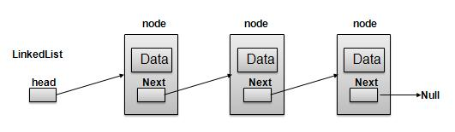
Linked List Representation
As per above shown illustration, following are the important points to be considered.
LinkedList contains a link element called first.
Each Link carries a data field(s) and a Link Field called next.
Each Link is linked with its next link using its next link
Last Link carries a Link as null to mark the end of the list.

Slide 18

TYPES OF LINKEDLIST
3 Types,
•Simple Linked List − Item Navigation is forward only.
•Doubly Linked List − Items can be navigated forward and backward way.
•Circular Linked List − Last item contains link of the first element as next and and first element has link to last element as prev.

Slide 19
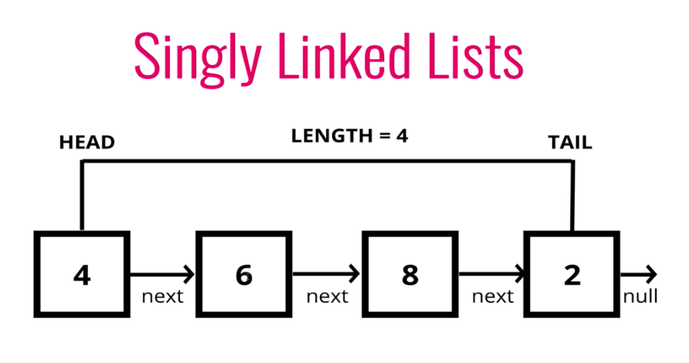
Singly linked list
A node in the singly linked list consist of two parts: data part and link part. Data part of the node stores actual information that is to be represented by the node while the link part of the node stores the address of its immediate successor.

Slide 20
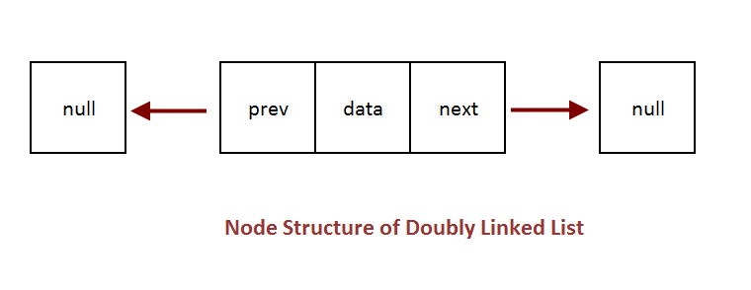
Doubly linked list
contains a pointer to the previous as well as the next node in the sequence.
consists of three parts: node data, next pointer,previous pointer

Slide 21
Circular Linked List
last node of the list contains a pointer to the first node of the list
traverse a circular linked list until we reach the same node where we started

Slide 22
Linked List Operations
•Traversal – Access the nodes of the list.
•Insertion – Adds a new node to an existing linked list.
•Deletion – Removes a node from an existing linked list.
•Search – Finds a particular element in the linked list.

Slide 23
Advantages Of Linked List:
Dynamic data structure
No memory wastage
Implementation
Insertion and Deletion Operations

Slide 24
Disadvantages Of Linked List
Memory usage
Traversal
Reverse Traversing
Difficult to share data
Not suited for small dataset

Slide 25
VECTORS

Slide 26
What is vectors ?
Vector is like the dynamic array which can grow or shrink its size.
Vectors have no size limit.
Vectors have additional features such as automatic resizing
It have the ability to add or remove elements at any position in the vector.
They are very similar to Array list, but Vector is synchronized and has some legacy methods that the collection framework does not contain.

Slide 27
VECTOR Constructors
Vector(): Creates a default vector of the initial capacity is 10.
Vector<E> v = new Vector<E>();
Vector(int size): Creates a vector whose initial capacity is specified by size.
Vector<E> v = new Vector<E>(int size);

Slide 28
CONSTRUCTORS
Vector(int size, int incr): Creates a vector whose initial capacity is specified by size and increment is specified by incr. It specifies the number of elements to allocate each time a vector is resized upward.
Vector<E> v = new Vector<E>(int size, int incr);
Vector(Collection c): Creates a vector that contains the elements of collection c.
Vector<E> v = new Vector<E>(Collection c);

Slide 29
OPERATIONS
Adding Elements:
In order to add the elements to the Vector, we use the add() method.
add(Object): This method is used to add an element at the end
of the Vector.
add(int index, Object): This method is used to add an element
at a specific index in the Vector.
Example:
v.add("apple");

Slide 30
OperatIONS
2. Updating Elements:
After adding the elements, if we wish to change the element, it can be done using the set() method.
Example:
v.set(0,"grape");// Using set() to replace 0th value with 21

Slide 31
operations
3. Removing Elements
In order to remove an element from a Vector, we can use the
remove().
remove(Object)
remove(int index)
Example:
v.remove("apple");

Slide 32
Operations
4. Iterating the Vector
There are multiple ways to iterate through the Vector. The most famous ways are by using the basic for loop in combination with a get() method
Example:
v.get(index);

Slide 33
VECTOR METHODS
capacity()
contains(Object o)
hashCode()
iterator()
size()
equals()

Slide 34
advantages
Dynamic size
Random Access
Thread Safe
Familiar Interface

Slide 35
DISADVANTAGES
Performance
Legacy Code
Unnecessary overhead

Slide 36
STACK

Slide 37
What is a Stack?
A Stack is a linear data structure that follows the LIFO (Last-In-First-Out) principle.
It contains only one pointer top pointer pointing to the topmost element of the stack.
Stack can be defined as a container in which insertion and deletion can be done from the one end known as the top of the stack.

Slide 38
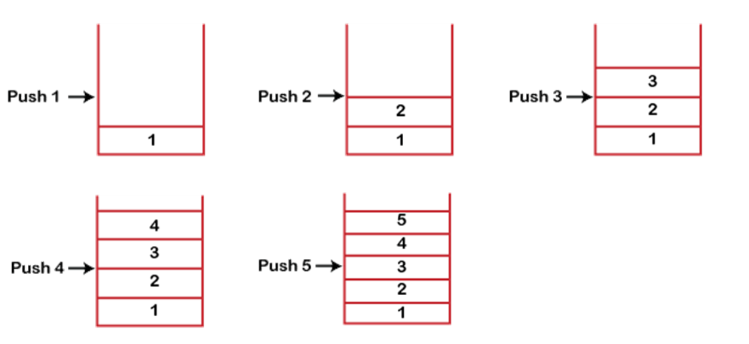
Working of Stack

Slide 39
Standard Stack Operations
push() : When we insert an element in a stack then the operation is known as a push.
pop() : When we delete an element from the stack, the operation is known as a pop.
isEmpty() : It determines whether the stack is empty or not.
isFull() : It determines whether the stack is full or not.
peek() : It returns the element at the given position.
count() : It returns the total number of elements available in a stack.
change() : It changes the element at the given position.
display() : It prints all the elements available in the stack.

Slide 40
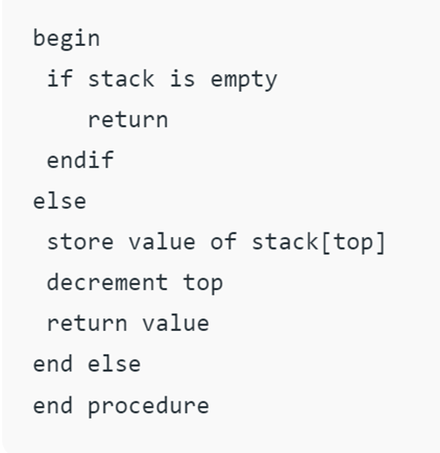
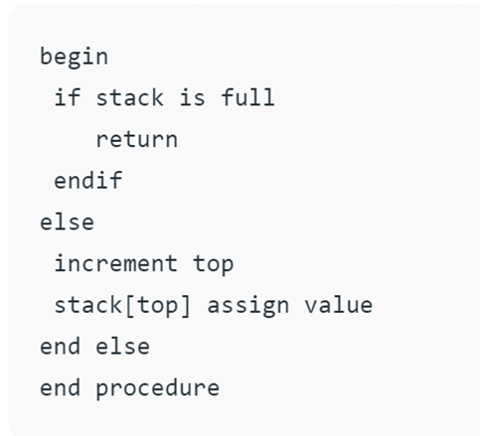
Pseudocodes
Push() pop()

Slide 41
Types of Stacks
Dynamic Size Stack:
When the stack is full, it automatically increases its size to accommodate the new element, and when the stack is empty, it decreases its size.
This type of stack is implemented using a linked list, as it allows for easy resizing of the stack.
Fixed Size Stack:
If the stack is full and an attempt is made to add an element to it, an overflow error occurs.
If the stack is empty and an attempt is made to remove an element from it, an underflow error occurs.

Slide 42
Implementation of Stack
Using array
push operation is implemented by incrementing the index of the top element and storing the new element at that index
pop operation is implemented by decrementing the index of the top element and returning the value stored at that index.
Advantages:
Easy to implement
Memory is saved as pointers are not involved.
Disadvantages:
It is not dynamic
The total size of the stack must be defined beforehand.

Slide 43
Implementation of Stack: Cont…
Using linked list
push operation is implemented by creating a new node with the new element and setting the next pointer of the current top node to the new node.
The pop operation is implemented by setting the next pointer of the current top node to the next node and returning the value of the current top nod
Advantages:
The linked list implementation of a stack can grow and shrink according to the needs at runtime.
It is used in many virtual machines like JVM.
•Disadvantages:
Requires extra memory due to the involvement of pointers
Random accessing is not possible in stack.

Slide 44
Applications of the stack
Infix to Postfix /Prefix conversion
Forward and backward features in web browsers
In Memory management
Stack also helps in implementing function call in computers. The last called function is always completed first.

Slide 45
Advantages
Maintains data in a LIFO manner
The last element is readily available for use
All operations are of O(1) complexity

Slide 46
Disadvantages
Manipulation is restricted to the top of the stack
Not much flexible

